Slide 1
Hypothesis Testing I: Introduction and Comparing means
bio5312 Fall2017
stephanie j. spielman, PhD

Slide 2
Statistical inference

Slide 3
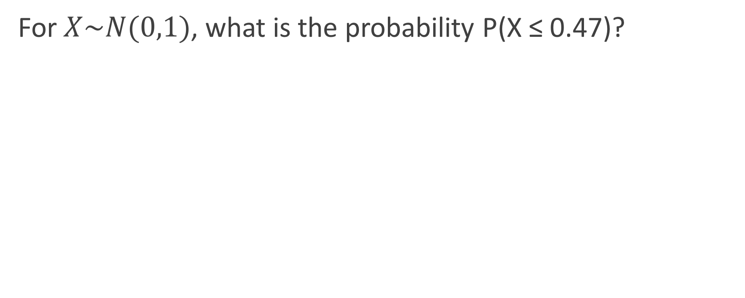
Recall from last week
For $X\sim N(0,1)$, what is the probability P(X ≤ 0.47)?
# CDF: P(X <= 0.47)
> pnorm(0.47)
[1] 0.6808225

Slide 4
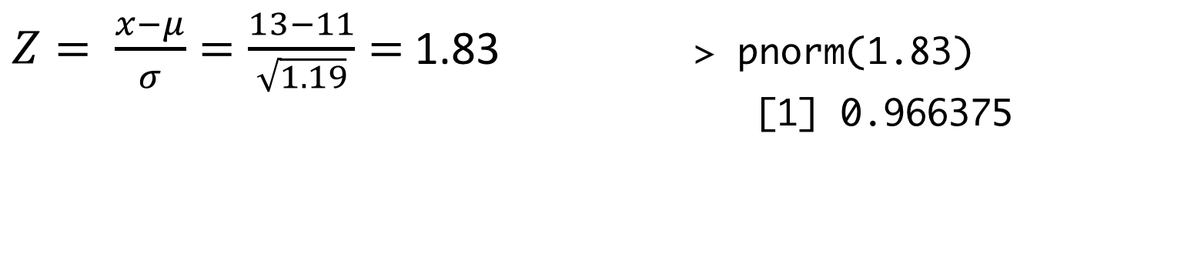
Computing probabilities for a population
Clownfish lengths are normally distributed as N(11, 1.9).
What is the probability that a clownfish is less than 13 cm?
$Z= \frac{x−μ}{σ}=\frac{13−11}{\sqrt{1.19}}=$ 1.83 > pnorm(1.83)
[1] 0.966375

Slide 5
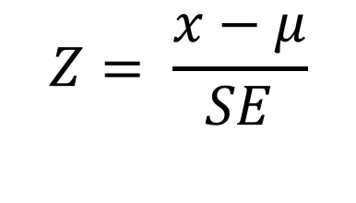
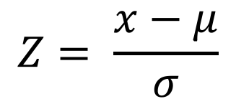
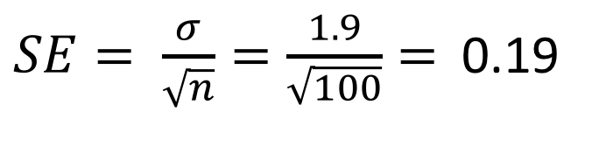
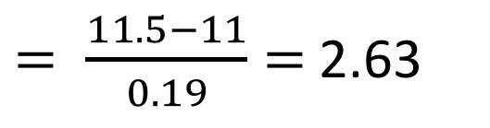
Computing probabilities for a sample
Clownfish lengths are normally distributed as N(11, 1.9).
What is the probability that a sample of 100 clownfish has a mean less than 11.5?
$$Z= \frac{x−μ}{σ}$$
$$Z= \frac{x−μ}{SE}$$
$= \frac{11.5−11}{0.19}=$ 2.63
> pnorm(2.63) [1] 0.9957308
$SE= \frac{σ}{\sqrt{n}}=\frac{1.9}{\sqrt{100}}=$ 0.19

Slide 6
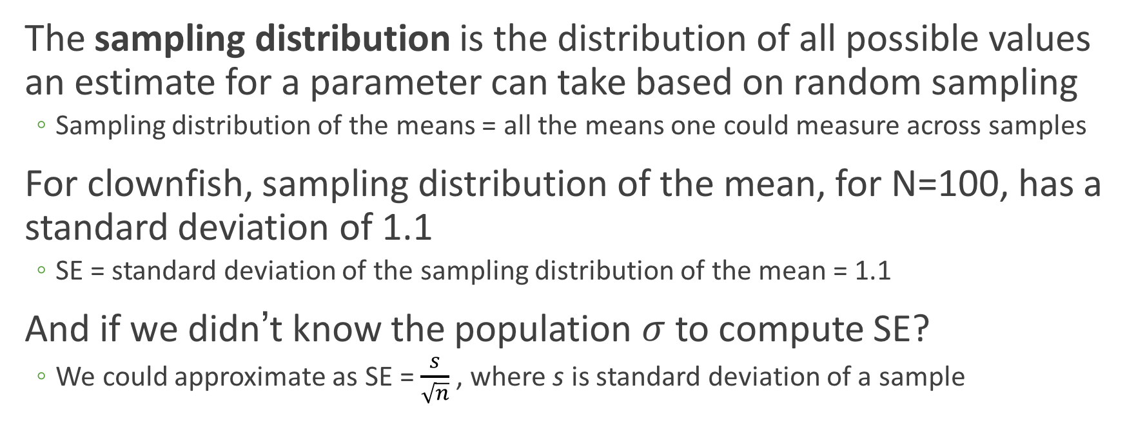
A return to sampling distributions
The sampling distribution is the distribution of all possible values an estimate for a parameter can take based on random sampling
Sampling distribution of the means = all the means one could measure across samples
For clownfish, sampling distribution of the mean, for N=100, has a standard deviation of 1.1
SE = standard deviation of the sampling distribution of the mean = 1.1
And if we didn’t know the population $σ$ to compute SE?
We could approximate as SE = $\frac{s}{\sqrt{n}}$ , where s is standard deviation of a sample

Slide 7
Hypothesis testing
Compare data (random sample) to the expectation of a specific null hypothesis
Hypothesis testing uses probability to answer whether an observed effect occurred by chance

Slide 8
Example scenario to use hypothesis testing
The polio vaccine was first tested in 1954.
~400,000 students were divided into two random groups:
Half received the vaccine, half received placebo
In vaccine group, 0.016% developed polio.
In placebo group, 0.057% developed polio.
We can use hypothesis testing to ask if the vaccine likely worked, or whether random chance likely caused results.

Slide 9
Hypothesis testing has null and alternative hypotheses
The null hypothesis H₀ makes a claim about the underlying population parameter
"Nothing interesting is going on"
Specific tests have specific null hypotheses
The alternative hypothesis H_{A} is what we would like to "know if it's true"
"Something we care about is going on"

Slide 10
Parametric vs. nonparametric hypothesis tests
Parametric tests assume that the data follow a particular known distribution
Distributions such as normal, binomial, chi-squared, etc.
Nonparametric tests make no assumption about the data and are "distribution-free"

Slide 11
The null distribution represents H₀
The null distribution is the sampling distribution of outcomes for a test statistic assuming the null is true
Hypothesis testing is sometimes referred to as null hypothesis significance testing
Hypothesis tests ask:
To what extent are my data expected under the null hypothesis?

Slide 12
Sampling distribution of the null hypothesis
X values in the tails are unlikely
X values in middle of the distribution are fairly likely

Slide 13
Sampling distribution of the null hypothesis
The total area of the critical regions is defined as 𝛂
Shaded areas are the Critical regions
critical value
critical value

Slide 14
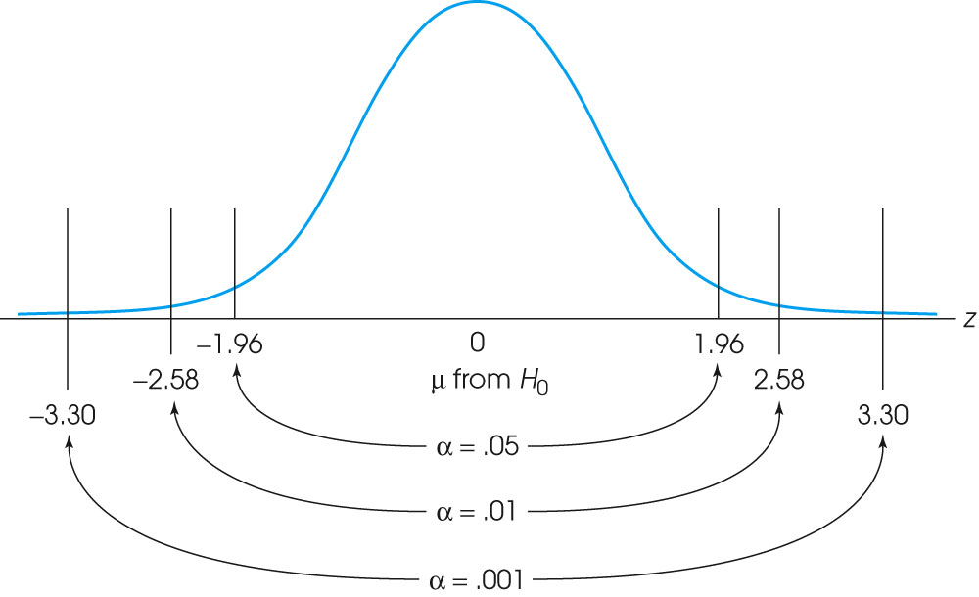
Critical values where N(0,1) is the null

Slide 15
The P-value is the area under the curve for your test statistic
Result of hypothesis test is significant if test statistic falls in the critical region
For test statistic = 2.25, the sum of area is less than 𝛂
NOTE: It will not always be symmetric
-2.25
2.25

Slide 16
Forming conclusions
Based on your pre-chosen α:
P-value <= α
Significant results allow us to reject the null hypothesis and conclude evidence in favor of the alternative hypothesis
P-value > α
We do not have significant results. We fail to reject the null hypothesis, and we have no evidence in favor of the alternative hypothesis.
The choice of α is totally arbitrary, but usually you will see 0.05 or 0.01

Slide 17
Error rates
α sets the overall false positive rate for our test procedure
If the null is true, we falsely reject the null 5% of the time for α=0.05
Truth about population (generally unknown)
 | Null is true | Alternative is true
Reject null (P<= α ) | Type I error (False positive) | True positive
Fail to reject null (P> α ) | True negative | Type II Error (False negative)
Conclusion

Slide 18
What type of error is it (or is it?)
A new arthritis drug does not have an effect in clinical trials, even though it actually does reduce arthritis pain.
A person with HIV receives a positive test result for HIV.
A person using illegal performing enhancing drugs passes a test clearing them of drug use.
A study found a significant relationship between neck strain and jogging, when reality there is no relationship.
An healthy individual gets a positive cancer biopsy result.
FN (type II)
No error
FN (type II)
FP (type I)
FP (type I)

Slide 19
One-sided vs. Two-sided (or –tailed)
One-sided tests are directional
Are my data larger/smaller than null?
Two-sided tests are non-directional
Do my data differ from null?
Is data < null?
Does data differ from null?
Total area = 𝛂
Is data > null?

Slide 20
One-sided vs. Two-sided tests
One-sided tests have more power than two-sided tests
Power = the ability to detect a true effect
Also known as true positive rate
One-sided tests are more limited in scope and can get you in trouble if you choose the wrong direction
You must choose only one test before you look at your data

Slide 21
Approach to hypothesis testing
Decide what question you are interested in answering
Determine the appropriate hypothesis test to use
Check that your data meet the assumptions* of the test
Compute the test statistic for your hypothesis test and the corresponding P-value
Draw conclusions using an a priori specified 𝛂 (P-value threshold)
*Parametric only

Slide 22
Hypothesis tests to compare means
Test the null hypothesis:
One sample test: The mean of my sample equals a null value
Two sample test: The mean of my two samples are equal (difference in means is 0)
Two options:
Z-test, where the null distribution is the standard normal N(0,1)
Test statistic is Z
t-test, where the null distribution is the Student's t distribution
Test statistic is t

Slide 23
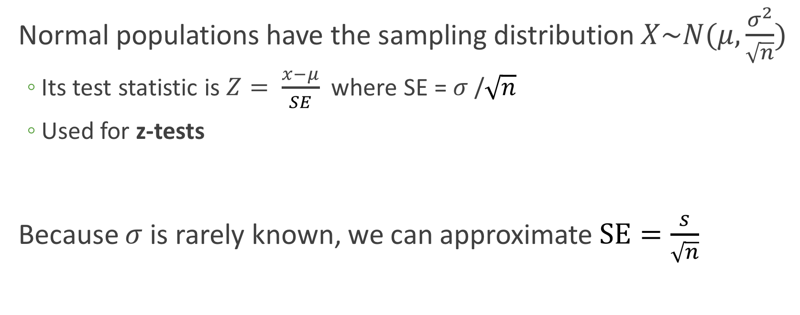
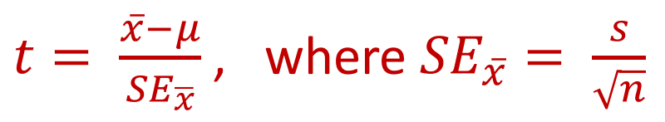
Z-tests vs t-tests
Normal populations have the sampling distribution $X\sim N(μ, \frac{σ^{2}}{\sqrt{n}})$
Its test statistic is $Z= \frac{x−μ}{SE}$ where SE = $σ$/$\sqrt{n}$
Used for z-tests
Because $σ$ is rarely known, we can approximate $SE=\frac{s}{\sqrt{n}}$
$t= \frac{\overline{x}−μ}{{SE}_{\overline{x}}}$, where ${SE}_{\overline{x}}= \frac{s}{\sqrt{n}}$

Slide 24
Standard normal and Student's t
Adding t distributions with increasing degrees of freedom
Standard normal N(0,1)
df = 2
df = 5
df = 15

Slide 25
Student's t where df = 100

Slide 26
Properties of the t distribution
As df approaches ∞, the t distribution approaches N(0,1)
Usually, df = n – 1, where n is sample size
Like the normal distribution…
t distribution is symmetric
Mean = median = mode
Unlike the normal distribution…
t has *much fatter tails*

Slide 27
Test Assumptions
Sample is a random sample from its population
Sample data is normally distributed

Slide 28
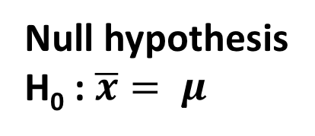
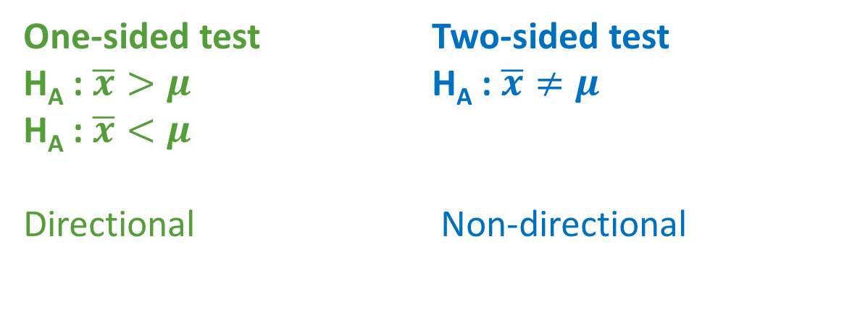
Dive right in: One sample t-test
Null hypothesis
H₀ : $\overline{x}= μ$
One-sided test
H_{A} : $\overline{x}>μ$
H_{A} : $\overline{x}<μ$
Directional
Two-sided test
H_{A} : $\overline{x}≠μ$
Non-directional

Slide 29
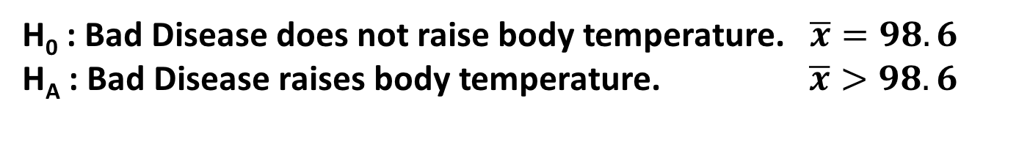
Performing a one-sample t-test
I want to know if the disease, Bad Disease, influences human body temperature. We know that standard human body temperature is 98.6 degrees F. I measured the temperatures for a random sample of 15 individuals with Bad Disease. On average, they have a temp of 99.59 degrees F.
Does Bad Disease raise body temperature?
> head(bad.disease.temp)
temp
1 98.17420
2 97.62137
3 99.60920
4 100.44158
5 99.75483
6 100.28846
> mean(bad.disease.temp$temp)
[1] 99.594
H₀ : Bad Disease does not raise body temperature. $\overline{x}=98.6$
H_{A} : Bad Disease raises body temperature. $\overline{x}>98.6$

Slide 30
Checking assumptions of the test
The t-test assumes that our sample data is normally distributed
Hard to tell if normal from histogram!

Slide 31
Assessing normality with a Q-Q plot
Quantile-Quantile plots graphically show if two datasets come from the same distribution
If the points follow the "expectation" line, datasets are similarly distributed
Ideal scenario. Data is normal
Data is not normal
Close enough, let's say normal

Slide 32
Granular data is also normal!

Slide 33
Making a Normal Q-Q plot
> head(bad.disease.temp)
temp
1 98.17420
2 97.62137
3 99.60920
4 100.44158
5 99.75483
6 100.28846
## Uses base R, not ggplot ##
> qqnorm(bad.disease.temp$temp, pch=20)
> qqline(bad.disease.temp$temp, col="red")
Data approximately follow the QQ line. Therefore, assumptions have been met and we can run the test.

Slide 34
Performing the t-test
Calculate the test statistic
See where test statistic falls on its distribution
Compute P-value as area under the curve past this statistic
The P-value is the probability of obtaining a test statistic as large or larger than that recovered

Slide 35
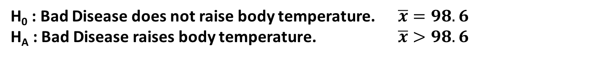
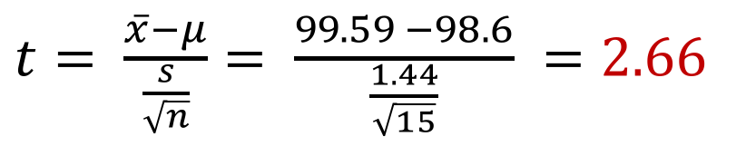
Compute the test statistic, t
H₀ : Bad Disease does not raise body temperature. $\overline{x}=98.6$
H_{A} : Bad Disease raises body temperature. $\overline{x}>98.6$
> mean(bad.disease.temp$temp)
[1] 99.594
> sd(bad.disease.temp$temp)
[1] 1.438273
> nrow(bad.disease.temp)
[1] 15
$t= \frac{\overline{x}−μ}{\frac{s}{\sqrt{n}}}= \frac{99.59 −98.6}{\frac{1.44}{\sqrt{15}}} =2.66$
this is our test statistic, t_{2.66}
More precisely, t_{2.66, df=14}

Slide 36

Find where the statistic falls in distribution
Our null distribution is a t distribution with df = 14 (15-1)
This area is our P-value because we test if $\overline{x}>98.6$
## P(X >= 2.66) ##
> 1 – pt(2.66, 14)
0.009
2.66

Slide 37
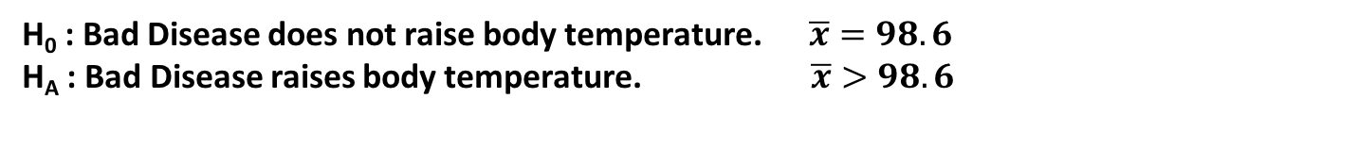
Forming conclusions
Our P=0.009, which is less than α=0.05. Therefore we reject the null hypothesis and we have evidence that Bad Disease raises body temperature.
H₀ : Bad Disease does not raise body temperature. $\overline{x}=98.6$
H_{A} : Bad Disease raises body temperature. $\overline{x}>98.6$

Slide 38
Approach to hypothesis testing
Decide what question you are interested in answering
Is the mean of my data equal to 98.6?
Determine the appropriate hypothesis test to use
Use a one-sample t-test
Check that your data meet the assumptions of the test
We confirmed the data is normally distributed
Compute the test statistic for your hypothesis test and the corresponding P-value
We found t = 2.66 and P=0.009
Draw conclusions using a specified P-value threshold
At 𝛂 = 0.05, we reject the null hypothesis and find evidence that Bad Disease raises body temp.

Slide 39
Effect size
The effect we observed here is 99.59 – 98.6 = 0.99
Statistical significance is not the same as biological significance
Comparison between red and blue samples will show a significant difference between means.
But does it matter?

Slide 40
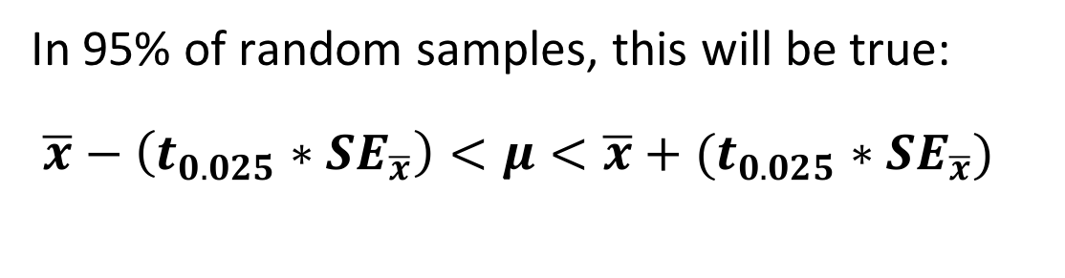
Confidence intervals
Range of values surrounding the sample estimate that is likely to contain the population parameter
Generally we calculate the 95% confidence interval (goes with 𝛂 = 0.05)
In 95% of random samples, this will be true:
$\overline{x}−\left(t_{0.025}∗{SE}_{\overline{x}}\right)<μ<\overline{x}+(t_{0.025}∗{SE}_{\overline{x}})$

Slide 41
95% Confidence Interval

Slide 42
Conceptualizing the CI
9/10 (~95%) of these random samples has a 95% confidence interval that overlaps the true mean

Slide 43
Does this figure represent 95% CIs?
NO. If anything, these are 40% CIs

Slide 44
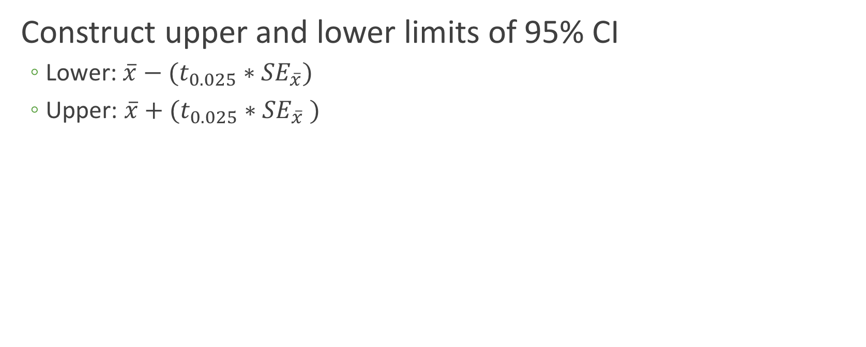
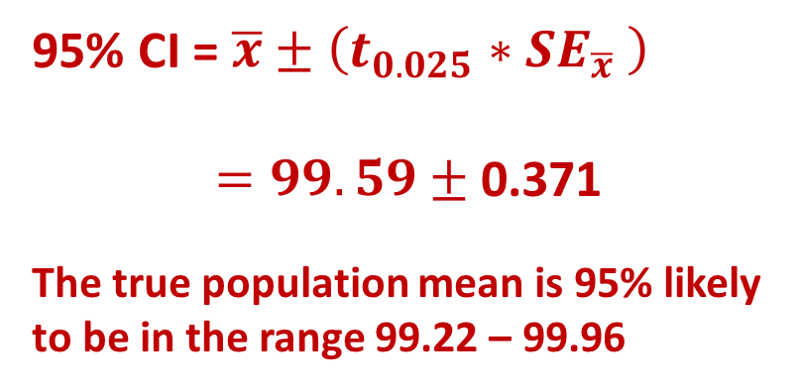
Calculating the CI
Construct upper and lower limits of 95% CI
Lower: $\overline{x}−(t_{0.025}∗{SE}_{\overline{x}})$
Upper: $\overline{x}+(t_{0.025}∗{SE}_{\overline{x}} )$
95% CI = $\overline{x}±\left(t_{0.025}∗{SE}_{\overline{x}} \right)$
$=99.59±$ 0.371
The true population mean is 95% likely
to be in the range 99.22 – 99.96
### Calculate t_0.025
> qt(0.025, 14)
[1] -2.144787
### Calculate t_0.025*SE
> t <- abs(qt(0.025, 14))
> se <- sd(bad.disease.temp$temp)/sqrt(15)
> t * se
[1] 0.3713605

Slide 45
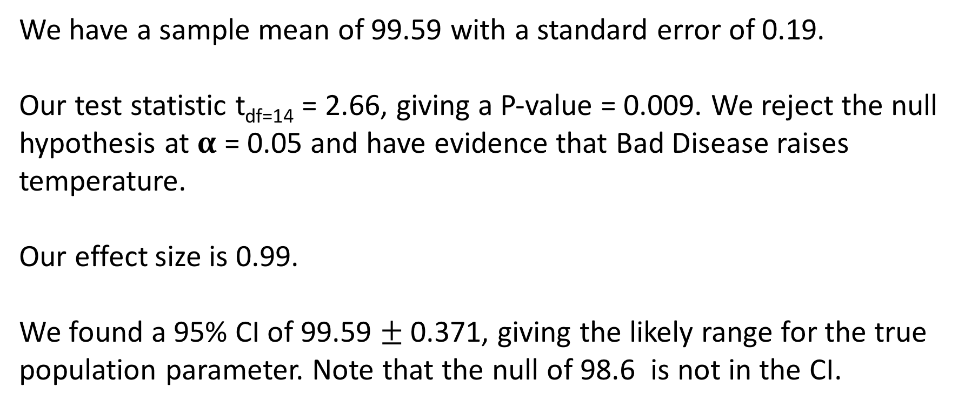
Bring it all together
We have a sample mean of 99.59 with a standard error of 0.19.
Our test statistic t_{df=14} = 2.66, giving a P-value = 0.009. We reject the null hypothesis at 𝛂 = 0.05 and have evidence that Bad Disease raises temperature.
Our effect size is 0.99.
We found a 95% CI of 99.59 $±$0.371, giving the likely range for the true population parameter. Note that the null of 98.6 is not in the CI.

Slide 46
Reporting non-significant results
Let's say we found t_{df=14} = 1.05 → P= 0.15
At 𝛂 = 0.05, we fail to reject the null hypothesis. We have no evidence that Bad Disease raises body temperature.
Does not mean that Bad Disease doesn't raise the temperature – our sample just had no evidence for this effect.
### Calculate P-value
> 1 - pt(1.05, 14)
[1] 0.1557531

Slide 47
What is a P-value?
The P-value is an area under the curve of the null distribution
It is therefore the probability of observing this effect or larger assuming the null hypothesis is true
P-value = P(effect or more observed | H₀ is true)
P-value = 0.009: If H₀ is true, I would obtain this effect or larger (t>=2.66) in 0.9% of such studies due to random sampling error

Slide 48
What is a P-value?
A low P-value means that the data are unlikely under the null
We therefore make an educated guess that there is probably something else going on, such as the alternative hypothesis
We can never rule out the possibility that results were fully consistent with null, just unlikely

Slide 49
P-values are not magic
P-values cannot evaluate whether H₀ or H_{A} is true
Large P-values do not prove the null is true
Small P-values do not prove the alternative is true. They merely suggest the null likely isn't.
P-values do not give the probability that you made the right conclusion
Two studies with the same P-value do not provide the same weight of evidence

Slide 50
Distribution of P-values
I perform 1000 t-tests on random samples from N(3.5, 1) and compare to null mean = 3.5. Therefore, null is true.
P <= 0.05 → False positives

Slide 51
Distribution of P-values
I perform 1000 t-tests on random samples from N(3.5, 1) and compare to null mean = 2. Therefore, null is false.
P <= 0.05 → True positives
Only ~67% of distribution!

Slide 52
P-values and effect size

Slide 53
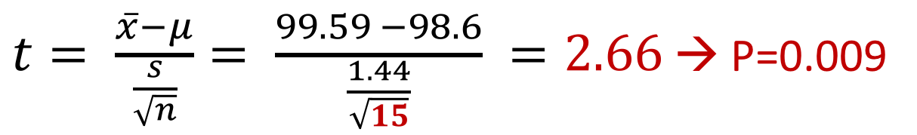
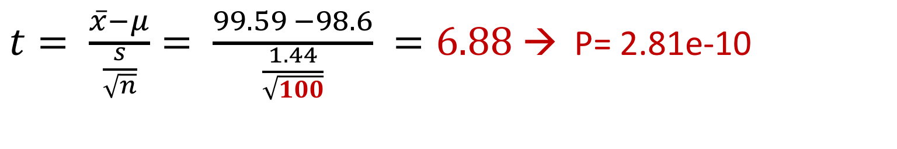
P-values are strongly influenced by sample size
$t= \frac{\overline{x}−μ}{\frac{s}{\sqrt{n}}}= \frac{99.59 −98.6}{\frac{1.44}{\sqrt{15}}} =2.66$ → P=0.009
$t= \frac{\overline{x}−μ}{\frac{s}{\sqrt{n}}}= \frac{99.59 −98.6}{\frac{1.44}{\sqrt{100}}} =6.88$ → P= 2.81e-10
Increasing sampling size increases power
Power is the probability you detect a true effect, i.e. true positive rate

Slide 54
P-values are kind of an accident
Personally, the writer prefers to set a low standard of significance at the 5 percent point . . . . A scientific fact should be regarded as experimentally established only if a properly designed experiment rarely fails to give this level of significance.
- R.A. Fisher

Slide 55
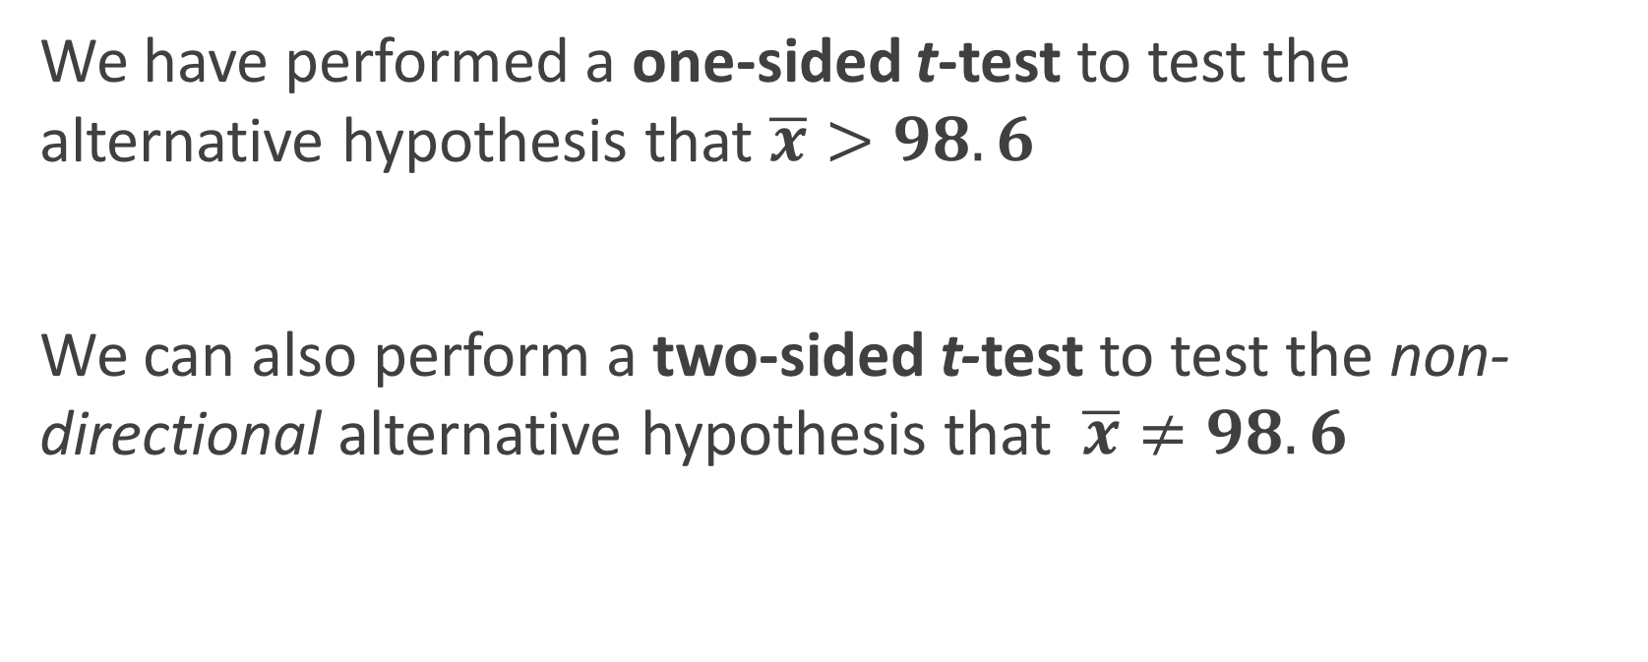
To recap
We have performed a one-sided t-test to test the alternative hypothesis that $\overline{x}>98.6$
We can also perform a two-sided t-test to test the non-directional alternative hypothesis that $\overline{x}≠98.6$

Slide 56
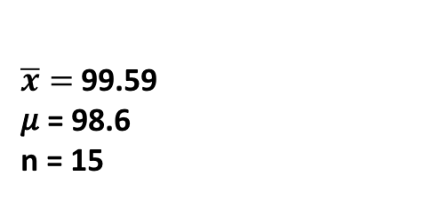
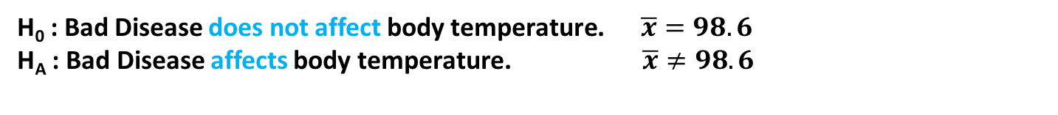
Compute the test statistic, t
$\overline{x}=$99.59
𝜇 = 98.6
n = 15
H₀ : Bad Disease does not affect body temperature. $\overline{x}=98.6$
H_{A} : Bad Disease affects body temperature. $\overline{x}≠98.6$
> head(bad.disease.temp)
temp
1 98.17420
2 97.62137
3 99.60920
4 100.44158
5 99.75483
6 100.28846
> mean(bad.disease.temp$temp)
[1] 99.594
> sd(bad.disease.temp$temp)
[1] 1.438273
$t= \frac{\overline{x}−μ}{\frac{s}{\sqrt{n}}}= \frac{99.59 −98.6}{\frac{1.44}{\sqrt{15}}} =2.66$
this is our test statistic, t_{2.66}
More precisely, t_{2.66,df=14}

Slide 57
Computing the P-value
For a two-sided test, we consider both extremes
This combined area is our P-value = 0.018
## P(X >= 2.66) or P(X<=-2.66)
> 2 * (1 - pt(2.66, 14))
0.01806
-2.66
2.66

Slide 58
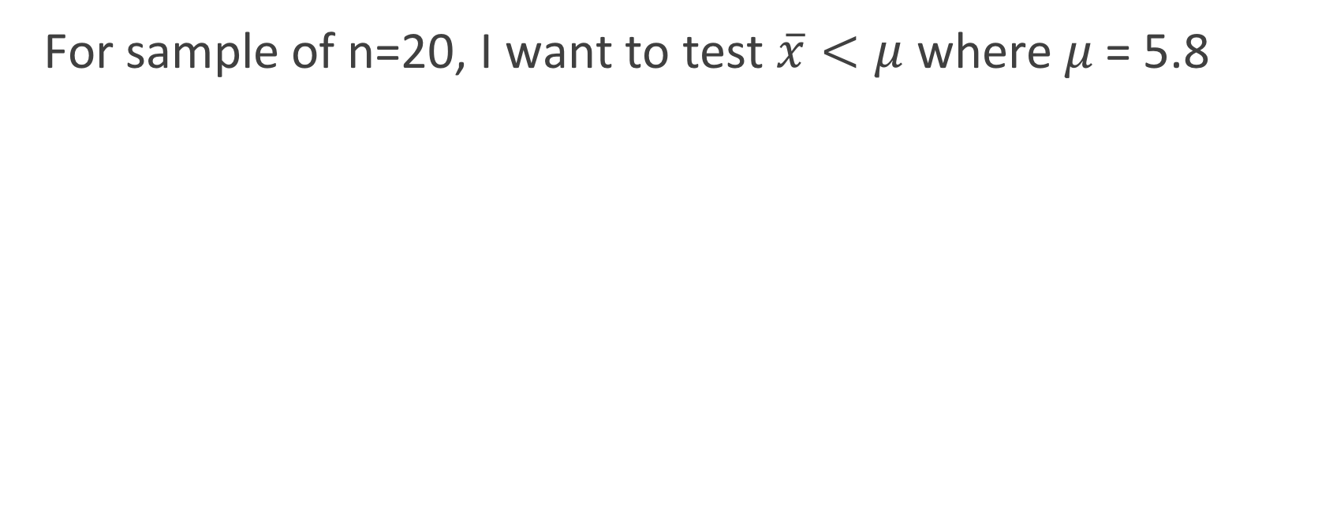
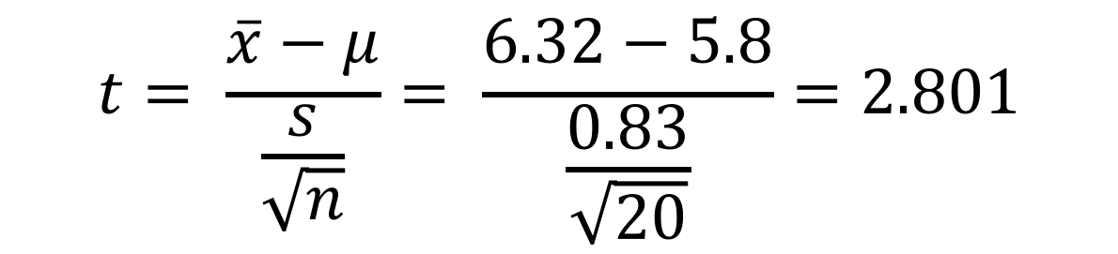
When running a one-sided t-test goes wrong
For sample of n=20, I want to test $\overline{x}<\text{μ}$ where 𝜇 = 5.8
> head(example.sample)
values
1 5.511307
2 5.012612
3 6.178421
4 7.587568
5 6.892165
6 5.197049
> mean(example.sample$values)
[1] 6.325366
> sd(example.sample$values)
[1] 0.8295474
$$t= \frac{\overline{x}−μ}{\frac{s}{\sqrt{n}}}= \frac{6.32−5.8}{\frac{0.83}{\sqrt{20}}}=2.801$$

Slide 59

The area below the statistic is our P-value for $\overline{x}<\text{μ}$
> pt(2.801, 19)
[1] 0.9943006
2.801

Slide 60
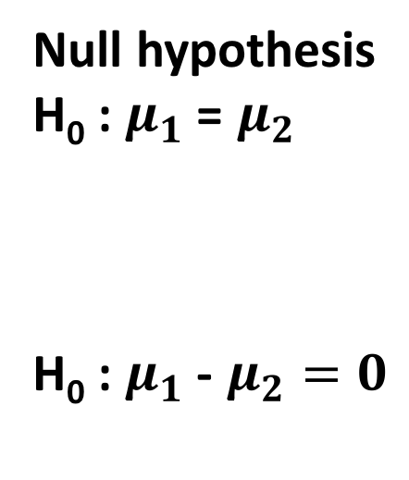
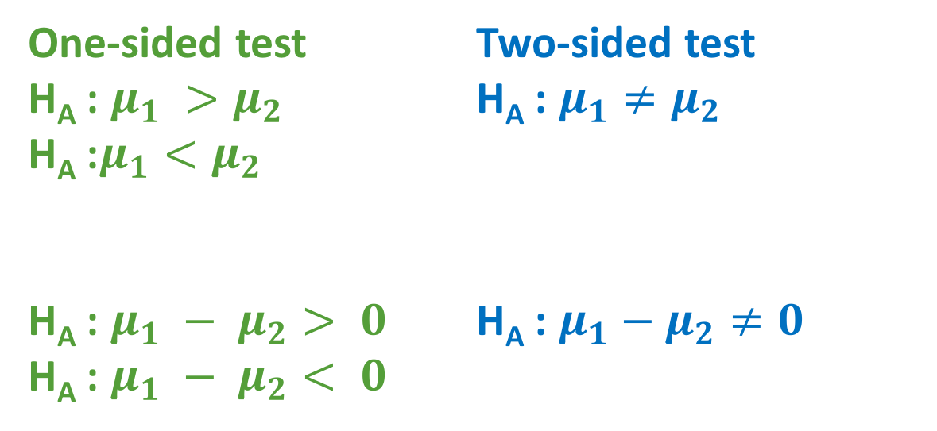
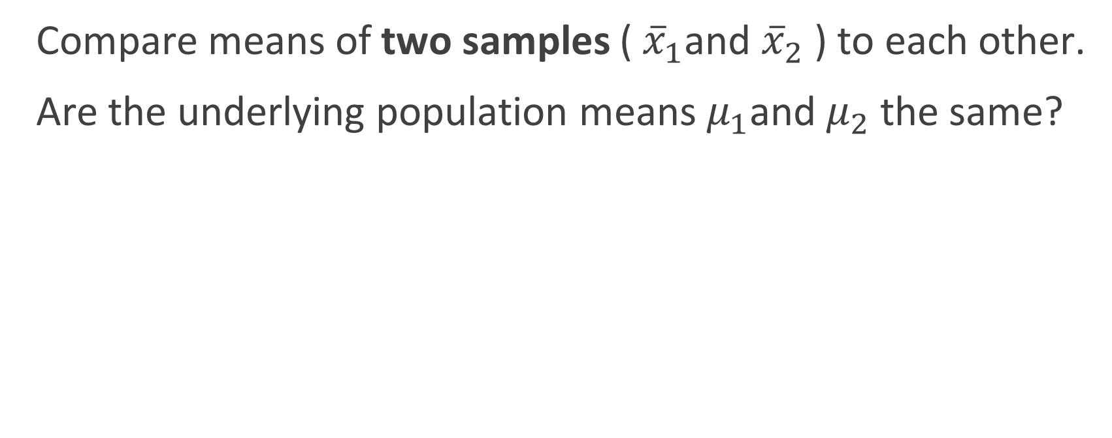
Two-sample t-tests
Compare means of two samples (${\overline{x}}_{1}$and ${\overline{x}}_{2}$ ) to each other.
Are the underlying population means $μ_{1}$and $μ_{2}$ the same?
Null hypothesis
H₀ : $μ_{1}$ = $μ_{2}$
H₀ : $μ_{1}$ - $μ_{2}=0$
One-sided test
H_{A} : $μ_{1} >μ_{2}$
H_{A} :$μ_{1}<μ_{2}$
H_{A} : $μ_{1} − μ_{2}> 0$
H_{A} : $μ_{1} − μ_{2}< 0$
Two-sided test
H_{A} : $μ_{1}≠μ_{2}$
H_{A} : $μ_{1}−μ_{2}≠0$

Slide 61
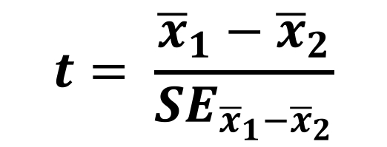

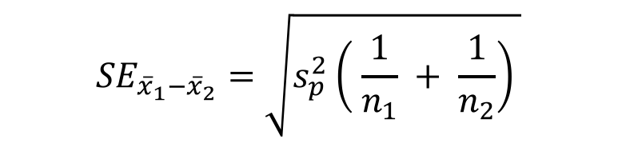

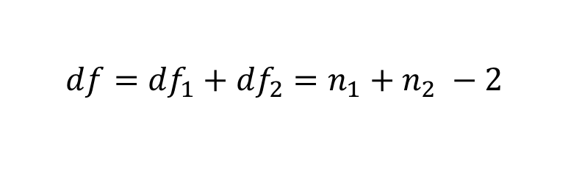
Formulas for two-sample t-test
$$t= \frac{{\overline{x}}_{1}−{\overline{x}}_{2}}{{SE}_{{\overline{x}}_{1}−{\overline{x}}_{2}}}$$
$${SE}_{{\overline{x}}_{1}−{\overline{x}}_{2}}=\sqrt{s_{p}^{2}\left( \frac{1}{n_{1}} + \frac{1}{n_{2}}\right) }$$
Standard error for two samples
$$s_{p}^{2}=\frac{{df}_{1}s_{1}^{2}+{df}_{2}s_{2}^{2}}{{df}_{1}+{df}_{2}}$$
Pooled sample variance
$$df={df}_{1}+{df}_{2}=n_{1}+n_{2} −2$$
Degrees of freedom for t distribution

Slide 62
Two-sample t-test assumptions
Both samples must be distributed normally
Samples should have equal variances
F-test can compare variances of samples to check assumption, but it is highly sensitive and will "too often" reject the null.
Levene's test will test for homogeneity of variances as well
Can use Welch's t-test when variance assumption is not met
For this class, we focus on normal assumption

Slide 63
Two-sample vs. paired t-test
Paired t-test is a special case where the two samples being compared have a natural pairing
Effectively a one-sample t-test where we test the if difference between two samples = 0
Paired t-test must check assumption that difference between means is normal
You can always perform a two-sample instead of paired, but paired will have more power

Slide 64
Paired scenarios
Making two measurements on each subject
Making repeat measurements on the same subject at two time points
Before and after treatment
Matching subjects with similar age, sex, etc.
Placing subject and control in close proximity

Slide 65
Is it paired or independent?
Triglyceride levels of a group of subjects is compared before and after taking a vitamin supplement.
For a clinical trial, one group is given a vitamin and the other a placebo. Their triglyceride levels are compared.
For a clinical trial, two groups with individuals matched for age, sex, and health history are given vitamin and placebo, respectively. Triglyceride levels are compared.
I measure free energies, between inactive and active conformations, for 30 enzymes.
A clinical trial tests a new drug on 20 sets of twins, giving, for each twin pair, one a placebo and one the drug. Comparisons between placebo and drug groups are made.
A clinical trial tests a new drug on 20 sets of twins, randomizing all individuals into a placebo group and or a drug group. Comparisons between groups are made.
Paired
Independent
Paired
Paired
Paired
Independent

Slide 66
Is it paired or independent?
Paired: Can I draw a line between individuals in groups?
Must be same N per group, by definition
Independent: No natural way to draw the lines.

Slide 67
Troubleshooting: Failure to meet normal assumption
1. If sample size is large enough (>~30), Central Limit Theorem kicks in and assumptions are effectively met
2. If sample is size is small (<~30) we can either:
Transform the data to be normal
Use a nonparametric test

Slide 68
Non-normal data

Slide 69
Data transformations
Log of data: x → log(x)
Square root of data: x → sqrt(x)
Inverse of data: x→ 1/x

Slide 70
Data transforms: Caution
Your test will now run on transformed data
Assume log transform performed and result has effect size 1.5
Actual effect size is exp(1.5) = 4.48
Be careful of 0's in data
1/0 and log(0) are undefined
Hack: Replace all 0's with tiny number like 1e-8
Instructor Editorializing:
Much like Z-tables, data transforms are mostly historical

